Slide 1
COMMUNICATIONS – IN THE OPTICAL DOMAIN
Parimal Ghosh
Assistant Professor
Department of Physics (PG & UG)
Banwarilal Bhalotia College
P O – Ushagram, Asansol – 713 303
Phone No – 0341 2274842 (O), 09434147190 (M)
E-mail: parimal34@gmail.com

Slide 2
Deliberation – at a glance
Introduction – modern communications and the necessity of communications in optical domain
First optical AM Link– Graham Bell’s the photo-phone
EM Spectrum and communications
Few historical milestones of OFC
Bandwidth and its importance in Communication
Optical Fiber – The ocean of Bandwidth
Advantages of OFC
Few Application areas of OFC
Limitations of OFC
Concluding remarks – future prospects

Slide 3
INTRODUCTION
  What is Communication ?
To communicate (Latin word ‘communico’ means to share) with any one at any place at any time is the ultimate goal of communications, i e, one to many and that many need not be limited in space and time.
Communication – the exchange of information between Human and Human, Human and Machine and also between machine and machine
.
  Why we are thinking of Communication in the ‘optical domain’ ?
Besides voice communications, to-days telephone companies promises to serve their customers ever increasing demands like
Audio, video, fax and data transmission, i e, SMS, MMS, GPRS etc
Internet and Video calling
e-mail services
Video Conferencing
finally different e-services, such as e - business, e-education, e-governance, e-banking, e-medical, e-ticketing and many more
Nearly exponential increasing need of the above services demands new requirements on the transmission media. The need for low loss, low dispersion, ultra wide bandwidth and high dynamic range, durability, upgradeability and low cost communication network have shifted the focus from traditional copper cable to optical fibre links.

Slide 4
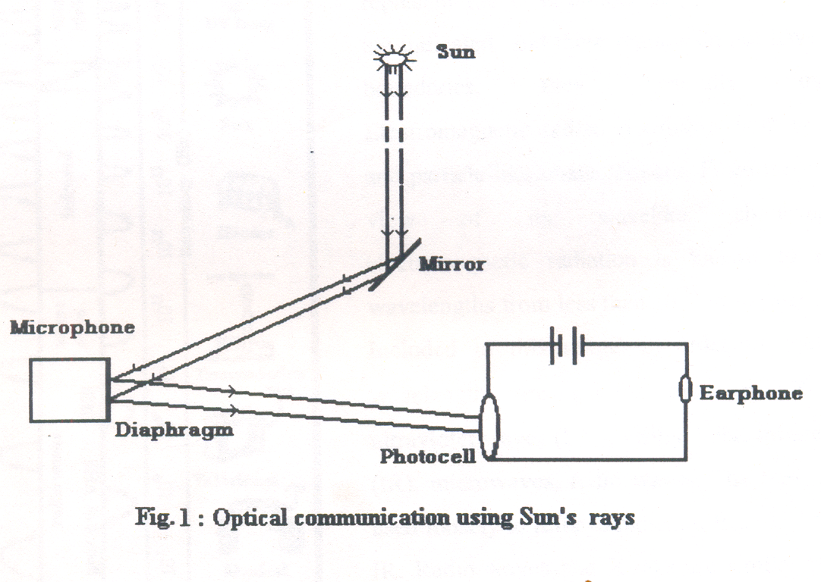
First optical AM Link– Graham Bell’s the photo phone
The idea of using light for communication, i e, transmit voice information was first developed by Alexander Graham Bell and demonstrated in 1880 with the remarkable experiment called ‘photophone’ as depicted in the following figure 1.
Transmitter
Receiver

Slide 5
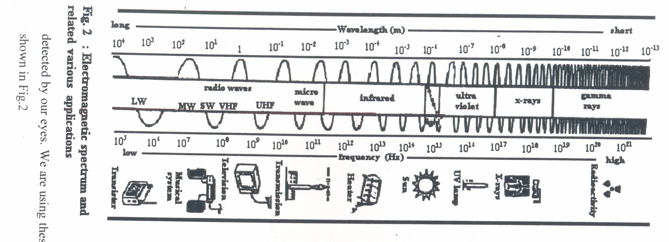
EM Spectrum and communications
Optical domain -- windows encompasses between IR and UV regions at the wavelengths around 0.85µm, 1.32µm, 1.55µm where attenuation is optimum.
Visible range 0.37µm – 0.74µm is not suitable due to high degree of attenuation
Commercial systems expected to come in the 4th window near 1.6µm. The region 1.26-1.65 µm offers the potential for BW as high as 50 THz

Slide 6
Frequency Bands for different communication means
Communication Frequency Bands | Signal Transmitted
0.1 MHZ -- 0.5 MHz | Telephone
0.55 MHZ -- 1.6 MHz | AM radio (MW)
1.6 MHZ -- 15 MHz | AM radio (SW)
41 MHZ -- 68 MHz | VHF low (TV) Band I
88 MHZ -- 108 MHz | FM radio
174 MHz – 254 MHz | VHF high (TV) Band II
470 MHz – 860 MHz | UHF (TV)
800 MHz – 900 MHz | Cell Phone
1800 MHz – 1900 MHz | Cell Phone
1 GHz – 40 GHz | Sat. Comn., RADAR, GPS, Radio Relay
1000THz – 5000 THz | Optical Communication

Slide 7
Few historical milestones of OFC
1870
1880
1950
1956
1960
John Tyndall – light may be allowed to follow a specific path using total internal reflection
William Wheeling patented his method of light transfer – “piping light”
Alexander Graham Bell developed the photo phone – the first optical AM audio link.
Narinder Kapany et al as well as Brian O’ Brien developed a fibroscope using the first glass coated fibre
Narinder Kapany introduced the name ‘Fibre optics’
T H Maiman first experimentally demonstrated the LASER, a high power, monochromatic highly directional source of light suitable for optical communication

Slide 8
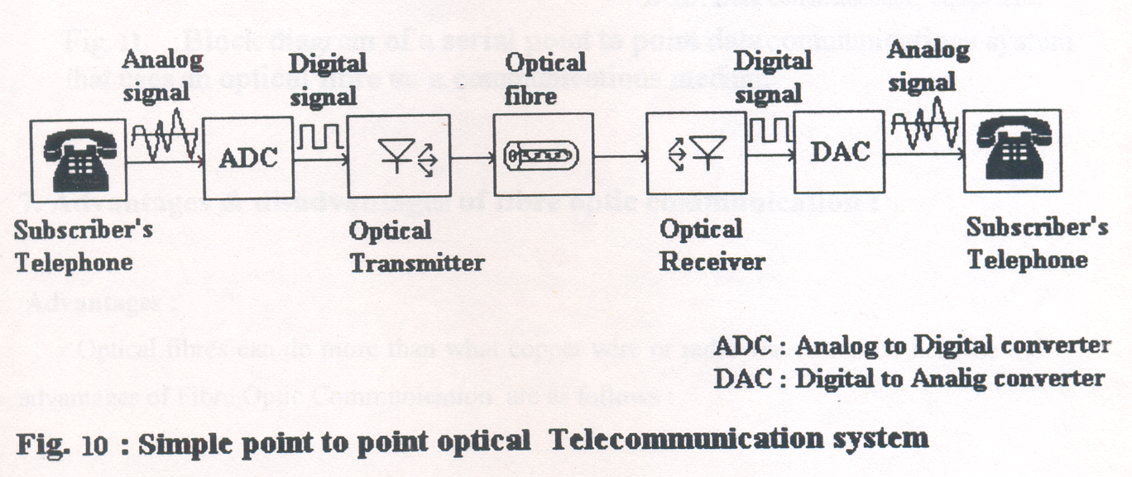
1966
1977
1990
Optical fiber was proposed as a medium to carry laser signals by channels Kao et al at Stanford Telecommunication.
Fibre optic telephone systems were installed for the time by American Telephone & Telegraph (AT &T).
Linn Mollenauer transmitted a 2.5 Gbps signal at a distance of 12,000KM without regeneration using a soliton laser and an erbium doped fiber optical amplifier
A TYPICAL FIBRE OPTIC POINT TO POINT TELEPHONE LINK

Slide 9
Bandwidth and its importance in Communication
Bandwidth – refers to capacity. It is expressed differently in Analog and Digital Systems. In Analog one it is the range of frequencies required to represent the information content. In digital system, bandwidth means the transmission speed or bit rate and is measured in Bits Per Second (bps).
Different digital services, such as ISDN (Individual channel bandwidth 64 Kbps), ATM has 622 Mbps bandwidth, MODEMs have transmission rate in the range of 64 Kbps upto several Mbps, T-1 circuits have 1.54 Mbps bandwidth. The bandwidth of several Analog services are given in the following Table.
Name of the Services | Signal BW | Channel BW
Telephone (Voice) Call | 3.4 KHz | 4 KHz
AM Radio (Voice + Music) | 5 KHz | 10 KHz
FM Radio ( Hi Fi Audio) | 15 KHz | 200 KHz
TV ( Video + Audio) | 5 MHz | 7 MHz
Facsimile (Data+ Text) | 4KHz | 4 KHz

Slide 10

LASER in 1960 - communications in the optical domain started taking shape using Graham Bell’s Photo-phone principle. Since the same bandwidth of 4 KHz is required irrespective of the carrier frequency, it is clear from the table, that increasing carrier from radio-waves to microwaves and then to optical wave, the option for no. of voice channels changes from 100 to 10 million and ultimately to 1 trillion. That’s why optical fibre is said to have ocean of bandwidth
Optical Fibre – the ocean of Bandwidth
Carrier Wave | Frequency Range | No of theoretically possible telephone Channels
Radio-waves | 100KHz – 500KHz | {(5-1)X10 ² }/4 = 100
Microwaves | 10 GHz – 50 GHz | {(50-10)X10 ⁶ }/4 = 10⁷
Optical Wave | 1,000 THz – 5,000THz | {(5-1)X10 ¹² }/4 = 10¹²

Slide 11
Advantages of OFC
Wide BW
Less Attenuation
Non- inductive and Non- conductive
No EMI – and hence no cross talk
Smaller in size, lighter in weight
Information tapping is virtually impossible
Easy availability and Easy Maintenance
Cost effective

Slide 12
Few application areas of OFC
Now-a-days optical fibre become the most popular medium for transmission of voice, data, video, text, graphics signals
Connecting Server and Work stations in a high speed LAN and WAN
Distribution of TV signals from MSO to local cable heads
Local access for broadband Telecom network
International links – either Terrestrial or Submarine
Apart from communications, optical fibres are being used in many different type of applications including optical inspection/surgery, non-contact sensing, traffic signs, museum illumination etc.
According to BSNL, over four and half lacs Km of OFC connecting all corners of India at present
Over 14,000 Km of OFC route in West Bengal alone
Over 2,500 Km of OFC route in Kolkata City

Slide 13
Limitations of OFC
Price :Fiber installation till today are not cheap compared to the conventional metallic wires. Also the other optical components and connectors are expensive as well.
Special Skills :Fibers can not be joined together as easily as metallic cables. Training of personnel and expensive precision splicing are important
Caution : Fibers use infra red light – causes serious injury when it strikes the retina of our eye. A common caution is that “never look directly into a live optical fiber”

Slide 14
Concluding remarks – future prospects
Generations of Optical Fiber Communication
Generations | Operating Wavelength | Attenuation | Transmission rate / Repeater Spacing
1st (1977) | 820 nm, ILD, Ga As, GaAlAs, MMGI Fiber | 3 to 8 dB/KM | 90 Mbps, 8-12 KM
2nd (1985) | 1300nm, LASER diode , SM fiber | 0.5 dB/KM | 565 Mbps, 45KM
3rd (1990) | 1550nm, LASER diode , SM fiber | 0.3dB/KM | 1.3 Gbps, 45Km
4th (1995) | 1550nm, dispersion shifted, dispersion flattered SM fiber | 0.2 dB/KM | 2 Gbps, 200KM

Slide 15
5th (Present and near future) | Coherent optical Comm, very narrow line width pulse at 1550nm and optical Amplifier | Minimum loss (<0.1 dB/KM) | Few Tera bits per second, over 500Km
Broad band networks with interactive communication providing multimedia services predicted to be the common practice in this century using optical fiber cable.
At Present over 80% communication networks is of OFC type. Expected in the near future that it will fully replace the traditional system.

Slide 16
THANKS A LOT FOR YOUR
PATIENCE AND KIND COOPERATION

